Slide 1
Title
Text

Slide 2
Exercise 1: Setup & Linear Least Squares
MAD
bacdavid@student.ethz.ch

Slide 3
Outline
Information
Goals
Theory/ Recap
Exercises
Setup instructions
git workflow example

Slide 4
Information

Slide 5
General
Lecture material & problem sets available here
Tutorial material available here

Slide 6
Goals

Slide 7
Goals of Today
Understand principle of linear least squares
Derive closed-form solution for linear least squares
Know different cases of data dimensionality & number of data points
Be able to set up git and python properly
Roughly understand the git workflow

Slide 8
Theory / Recap

Slide 9
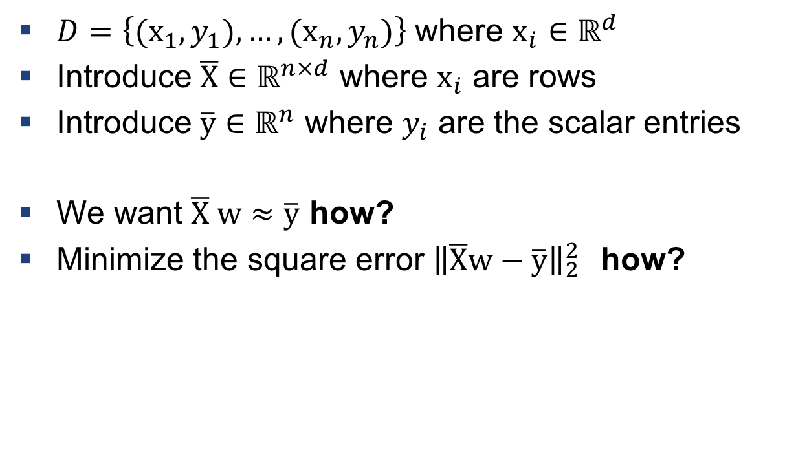
Linear Least Squares
$D=\left\{{(x}_{1},y_{1}), …,{(x}_{n},y_{n})\right\}$ where $x_{i}∈ℝ^{d}$
Introduce $\overline{X}∈ℝ^{n×d}$ where $x_{i}$ are rows
Introduce $\overline{y}∈ℝ^{n}$ where $y_{i}$ are the scalar entries
We want $\overline{X} w≈\overline{y}$ how?
Minimize the square error ${\left\|\overline{X}w−\overline{y}\right\|}_{2}^{2}$ how?

Slide 10
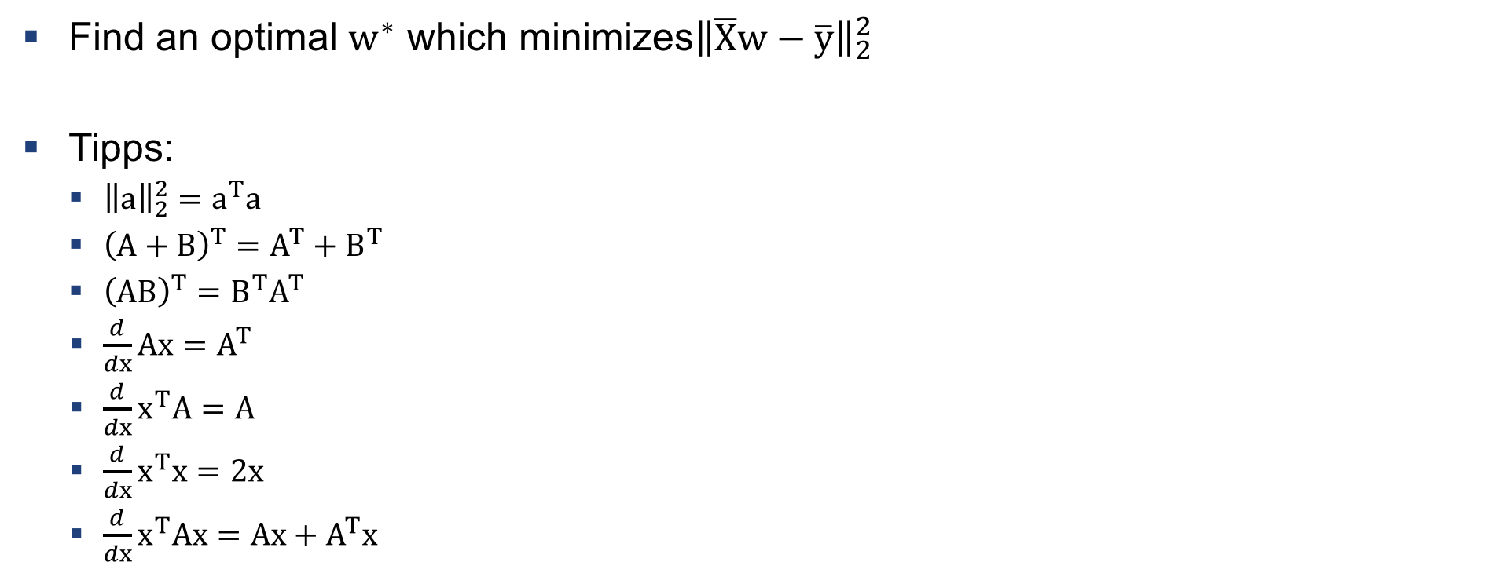
Example 1: Derive closed-form solution of LSQ
Find an optimal $w^{∗}$ which minimizes${\left\|\overline{X}w−\overline{y}\right\|}_{2}^{2}$
Tipps:
${\left\|a\right\|}_{2}^{2}=a^{T}a$
${\left(A+B\right)}^{T}=A^{T}+B^{T}$
${\left(AB\right)}^{T}=B^{T}A^{T}$
$\frac{d}{dx}Ax=A^{T}$
$\frac{d}{dx}x^{T}A=A$
$\frac{d}{dx}x^{T}x=2x$
$\frac{d}{dx}x^{T}Ax=Ax+A^{T}x$

Slide 11
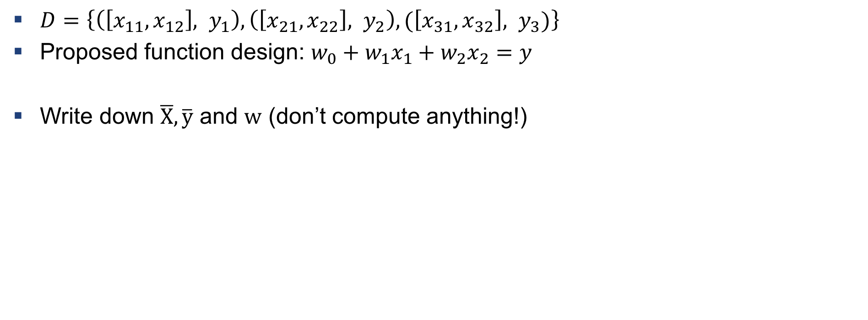
Example 2: Write down the matrices
$D=\left\{\left(\left[x_{11}, x_{12}\right], y_{1}\right), \left(\left[x_{21}, x_{22}\right], y_{2}\right), (\left[x_{31}, x_{32}\right], y_{3})\right\}$
Proposed function design: $w_{0}+w_{1}x_{1}+w_{2}x_{2}=y$
Write down $\overline{X},\overline{y}$ and $w$ (don’t compute anything!)

Slide 12
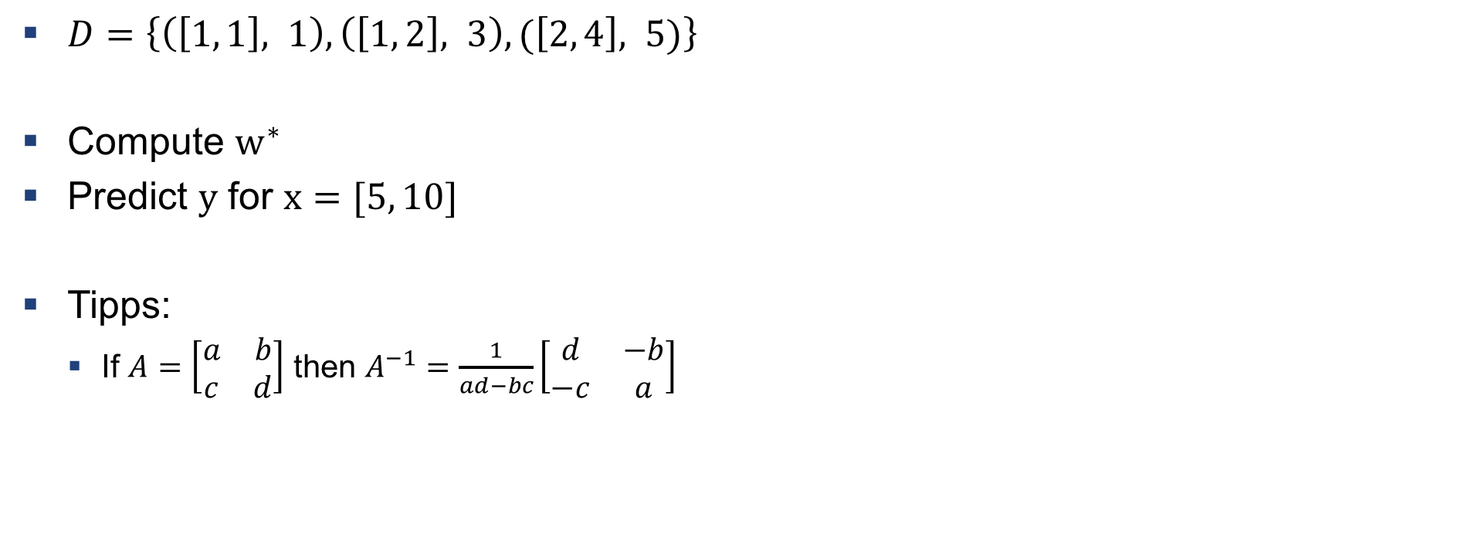
Example 3: Compute an example with LSQ
$D=\left\{\left(\left[1, 1\right], 1\right), \left(\left[1, 2\right], 3\right), (\left[2, 4\right], 5)\right\}$
Compute $w^{∗}$
Predict $y$ for $x=[5, 10]$
Tipps:
If $A=\left[\begin{matrix}a & b \\ c & d\end{matrix}\right]$ then $A^{−1}=\frac{1}{ad−bc}\left[\begin{matrix}d & −b \\ −c & a\end{matrix}\right]$

Slide 13
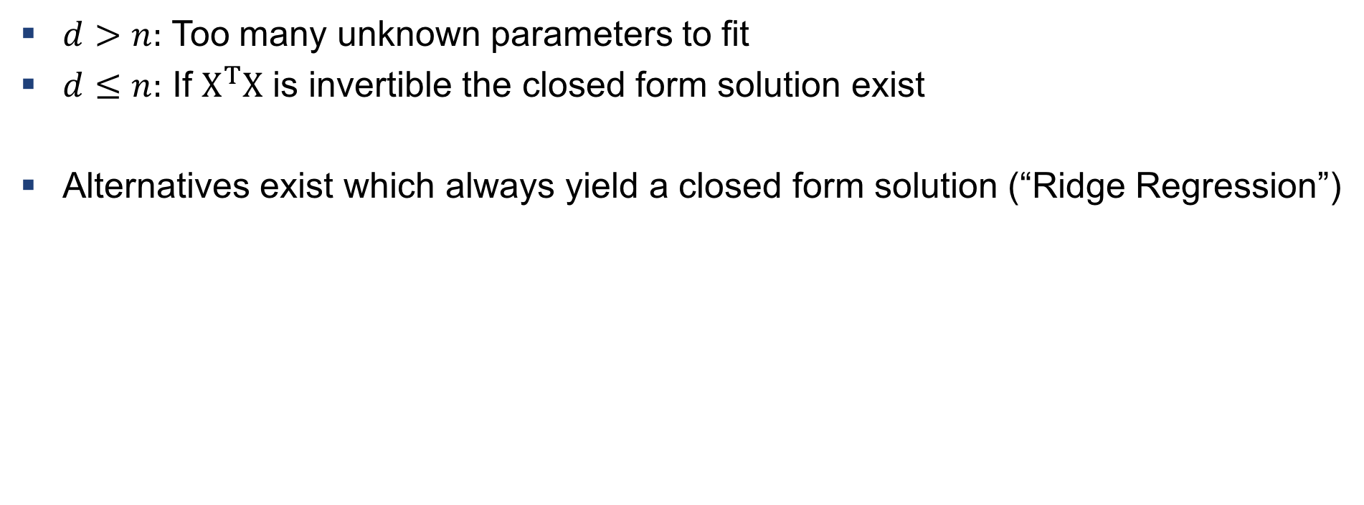
2 cases for LSQ
$d>n:$ Too many unknown parameters to fit
$d≤n:$ If $X^{T}X$ is invertible the closed form solution exist
Alternatives exist which always yield a closed form solution (“Ridge Regression”)

Slide 14
Exercises

Slide 15
Q1
Practical example of using LSQ on 2D data

Slide 16
Q2
Use LSQ on 3D data

Slide 17
Q3
Advanced question – not mandatory: Give it a try anyways!

Slide 18
Setup instructions

Slide 19
Setup python
Download and install python distribution from here
Download and install an editor such as Pycharm from here

Slide 20
Setup git
Download and install git from here

Slide 21
git workflow

Slide 22
Example 4: Setting up git project
Configure your git
git config --global user.name "bacdavid”
git config --global user.email bacdavid@student.ethz.ch
Create a project on gitlab.ethz.ch and locally (with Pycharm for instance) with a file hello.py
Navigate to your local project folder (use cd and ls)
cd bacdavid/PycharmProjects/hallo_world
Initialize git and push
git init
git remote add origin https://gitlab.ethz.ch/bacdavid/hello_world.git
git add .
git commit –m “Initial commit”
git push –u origin master

Slide 23
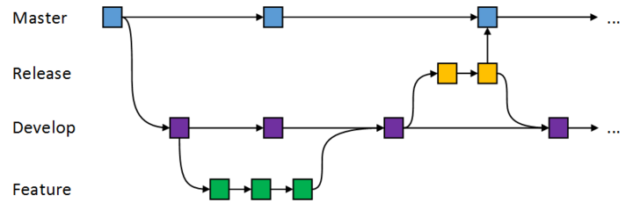
Example 5: Using git workflow
Create a new branch and switch to it
git branch “goodbye”
git checkout goodbye
git branch # shows the branch
Create a file goodbye.py next to hello.py
Commit and push
git add .
git commit –m “added goodbye file”
git push origin goodbye # on gitlab you should have two branches now
Switch to master branch and merge
git checkout master
git merge goodbye
git push origin master

Slide 24

Questions?

